Slide 1
Online Learning Applications Project Presentation
Alberto Eusebio - 10970712
Gianluigi Palmisano - 10782779
Martina Riva - 10756775

Slide 2
REQUIREMENT 1

Slide 3
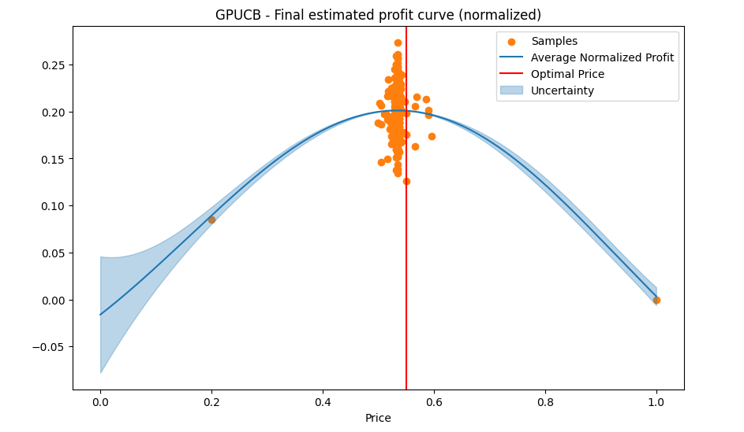
Requirement 1 - Pricing
Environment is Stochastic
Pricing with a continuous set of prices in [0,1]
Gaussian Process Upper Confidence Bound (GPUCB) for pricing learning
Sampled prices concentration is high close to the Optimal Price where uncertainty is quite low

Slide 4
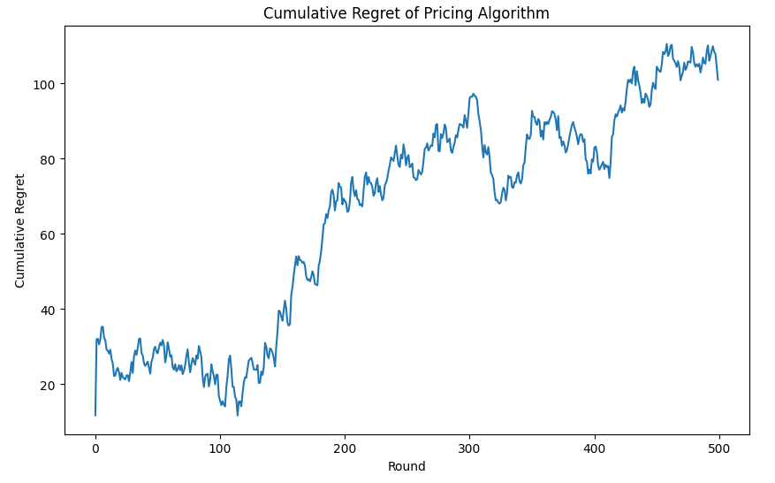
Requirement 1 - Pricing
Environment is Stochastic
Gaussian Processes (UCB) tends to overfit
Instabile behaviour
Cumulative Regret is sublinear
Theoretical guarantees of Õ(√T) are granted (under some assumptions)

Slide 5
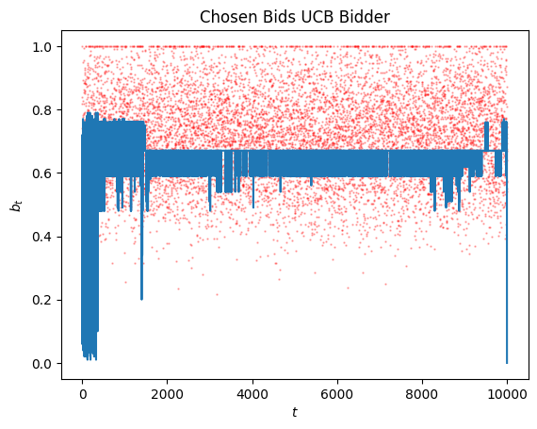
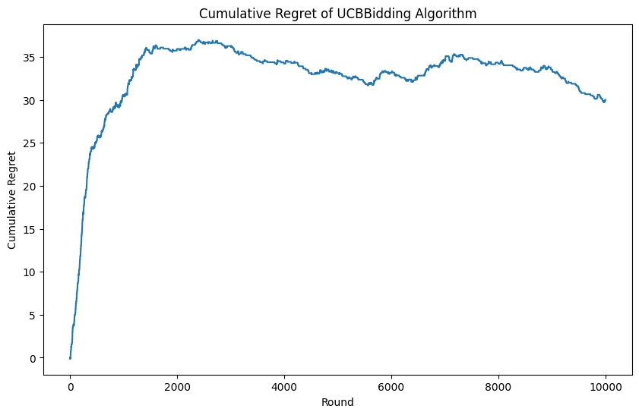
Requirement 1 - Bidding
Second price auctions (pay ≤ bid) truthful
A UCB-like algorithm (UCBBidding)
Bids start oscillating between maxima up to budget depletion
Cumulative Regret is sublinear
Setting
Number of advertisers: 4
Product valuation: 0.8
CTR: 0.4
Budget: 2000
T=10000

Slide 6
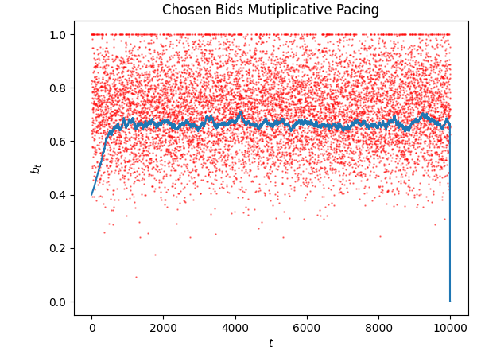
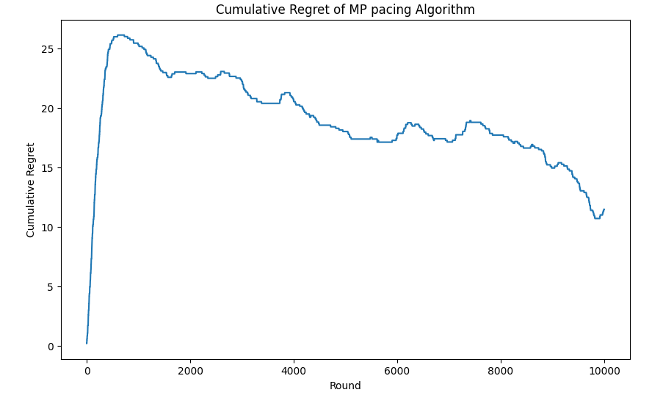
Requirement 1 - Bidding MP
Multiplicative Pacing: a primal-dual algorithm for truthful auctions:
In first phase algorithm is in exploration
Then when the optimal bid is found the cumulative regret start decreasing
Setting
Number of advertisers: 4
Product valuation: 0.8
CTR: 0.4
Budget: 2000
T=10000

Slide 7
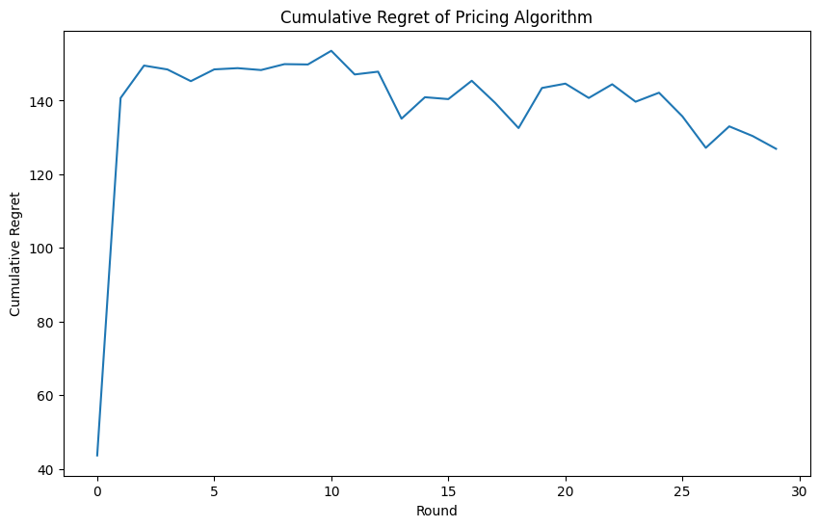
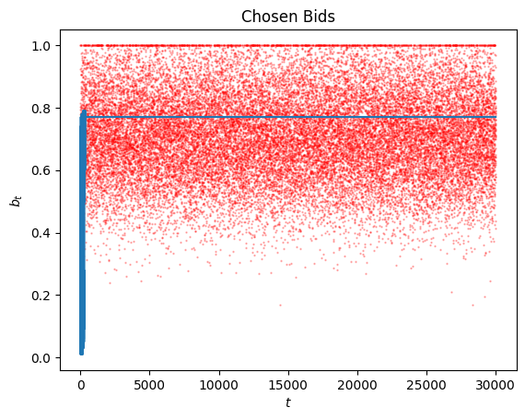
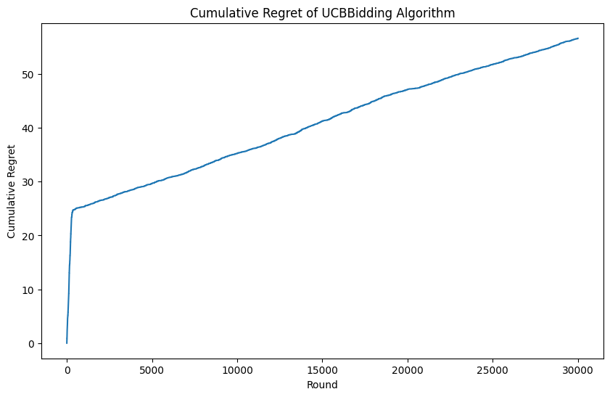
Requirement 1 - Pricing - Bidding
Simulation of a one month advertising campaign using an GPUCB for pricing and the UCB Bidding Agent for bidding
Setting
Numer of days: 30
Number of users per day: 1000

Slide 8
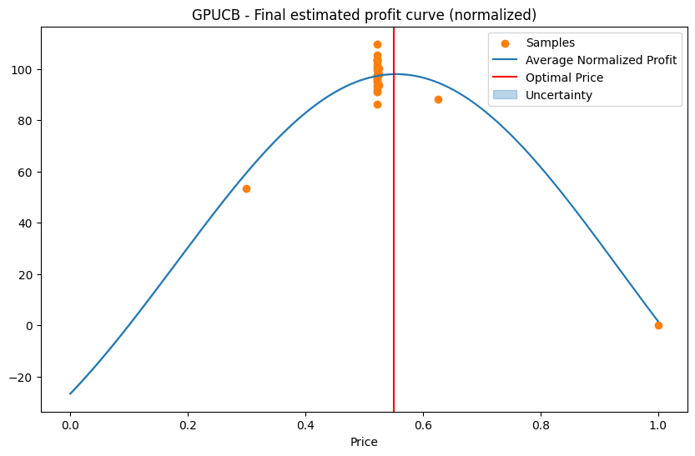
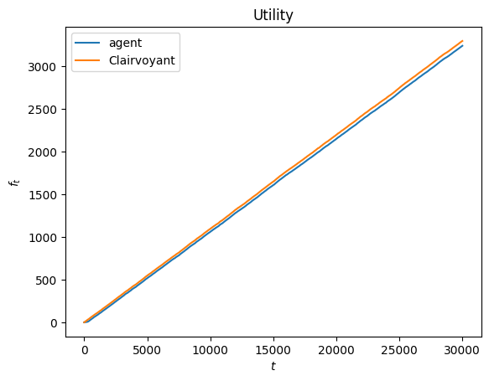
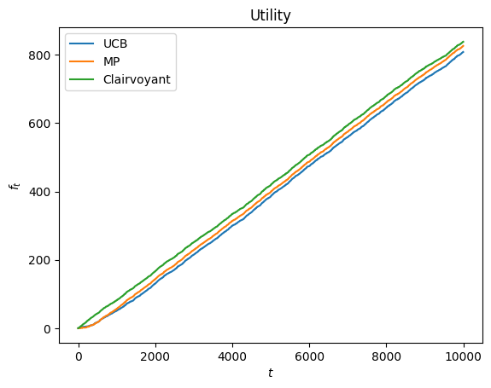
Requirement 1 - Utilities
UCB and MP utilities are coherent with Expected Clairvoyant
Agent’s trend is slightly worse than Clairvoyant, but it is still linear

Slide 9
REQUIREMENT 2

Slide 10
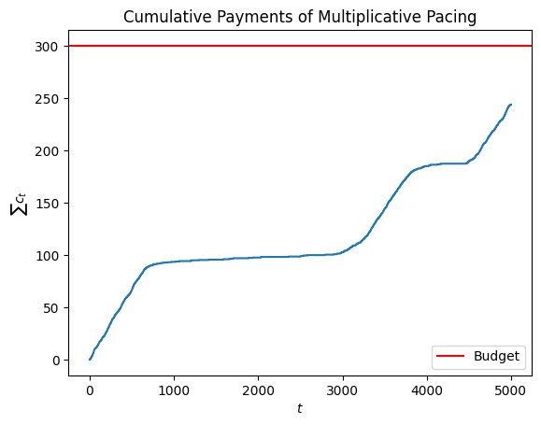
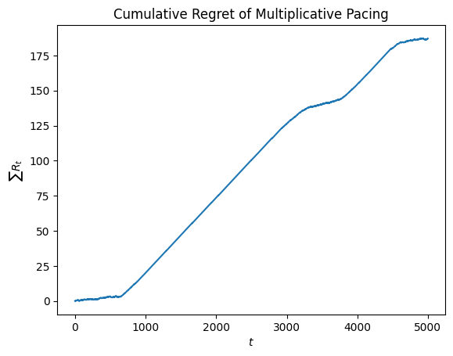
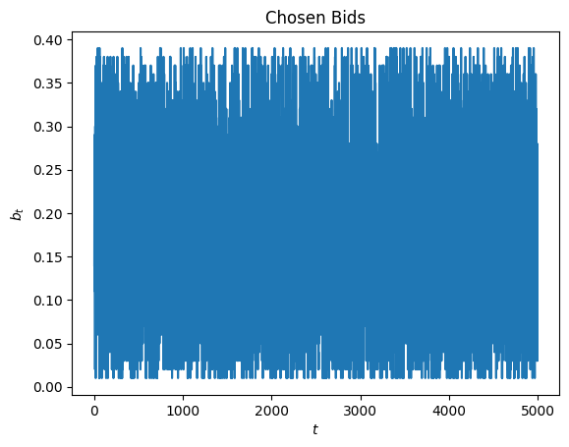
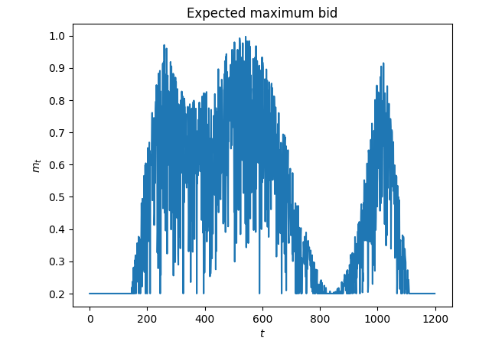
Requirement 2 - Bidding
Environment is highly non-stationary (adversarial)
Generalized First Price Auction (pay = bid)
Primal-dual algorithm for non-truthful auctions
We implement a Full Feedback Multiplicative Pacing
We achieved a sublinear regret

Slide 11
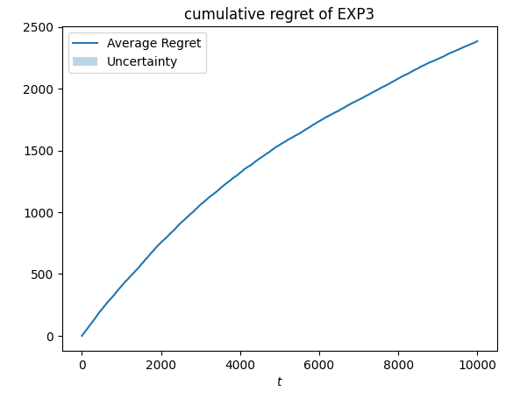
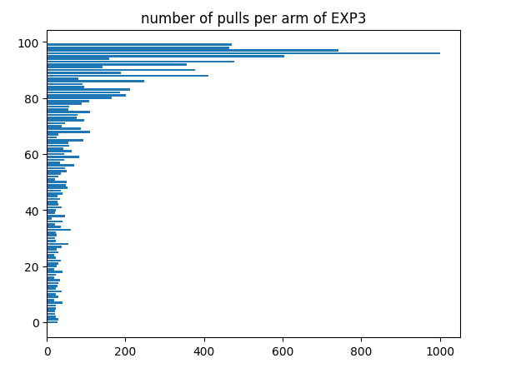
Requirement 2 - Pricing
Pricing with a discretized set of 100 prices in [0,1]
Highly non-stationary environment (Adversarial MAB problem) → we use a Non Stationary Bernoulli Environment
We used EXP3 with a learning rate: η=√(logK/KT) achieving a sublinear regret

Slide 12
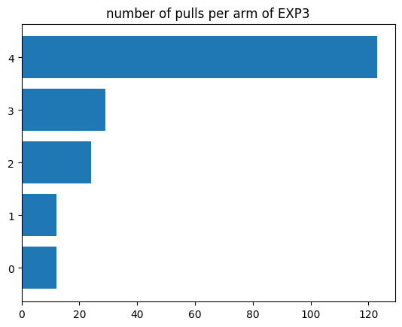
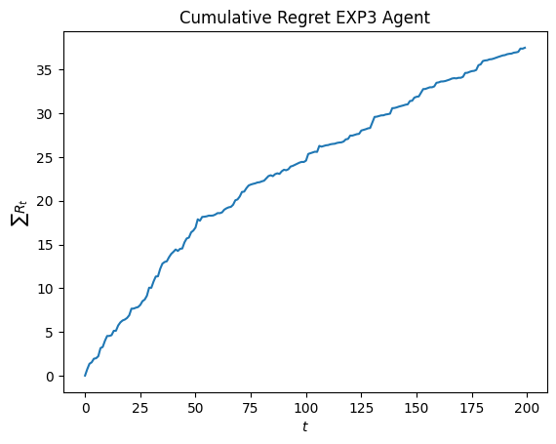
Requirement 2 - Pricing - Bidding
Simulation of a 100 days advertising campaign using an EXP3 for pricing and FFMultiplicative Pacing for bidding
Setting
Numer of days: 200
Number of users per day: 1000
Number of arms: 5

Slide 13
REQUIREMENT 3

Slide 14
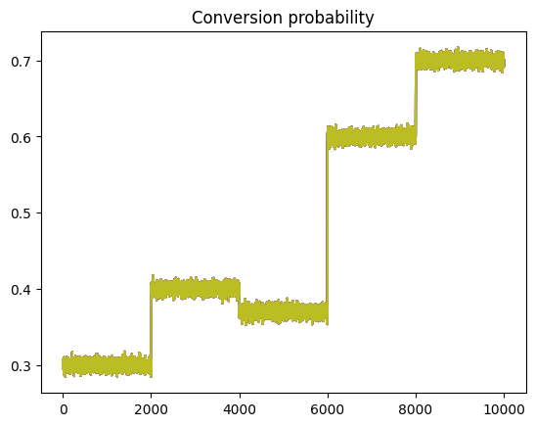
Requirement 3: Pricing
Non stationary environment
Days are partitioned in 5 intervals
In each interval the demand curve with noise is different
Discretization of the prices in [0,1]

Slide 15
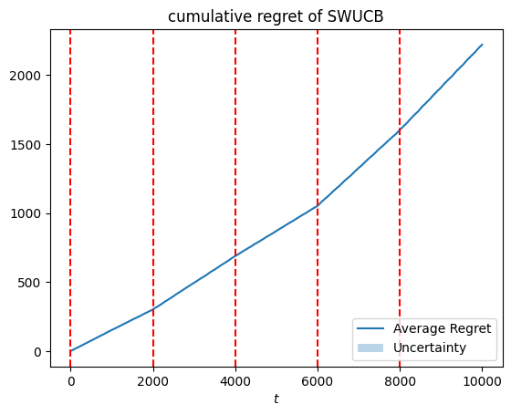
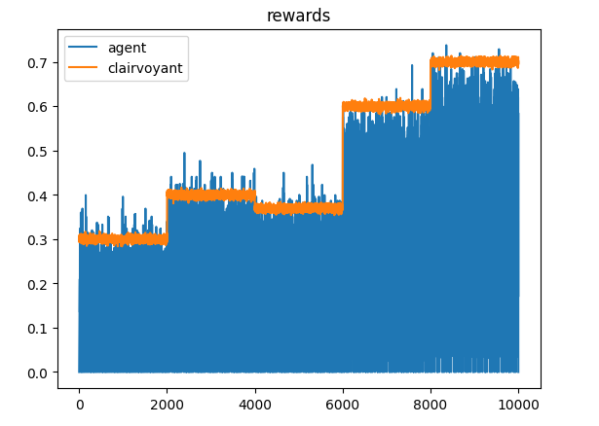
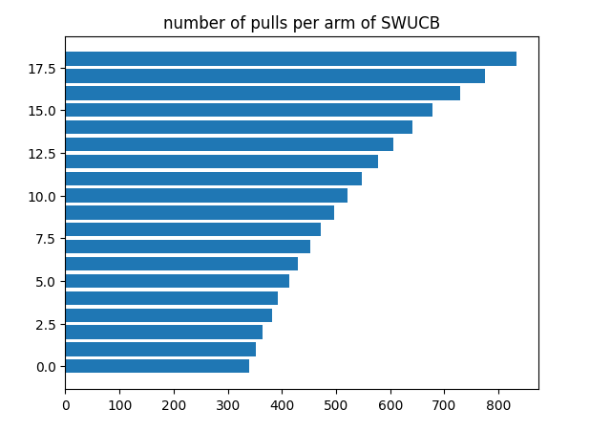
Requirement 3: Sliding Window
Sliding Window UCB Agent
Using the sliding window allow to continuously explore, and so it effectively handles non-stationary environments.
Cumulative Regret trend appears to be approximately linear

Slide 16
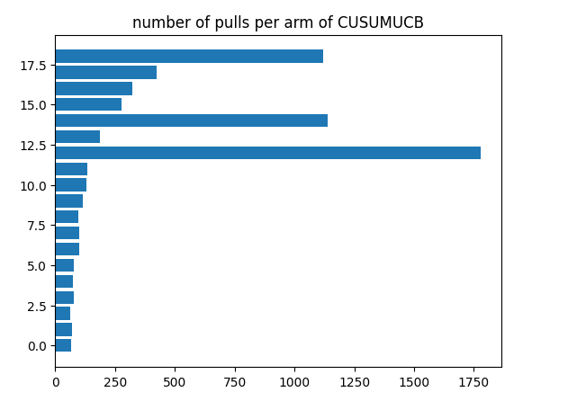
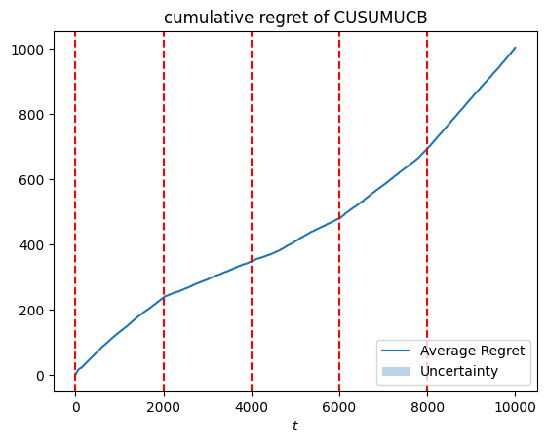
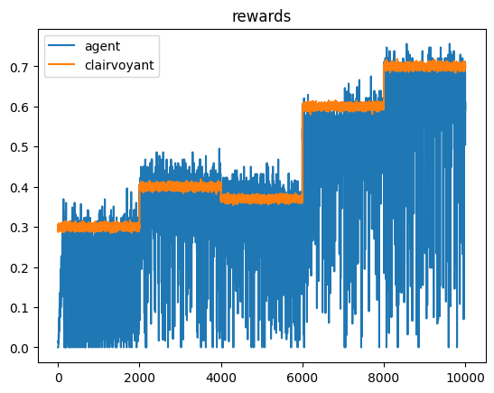
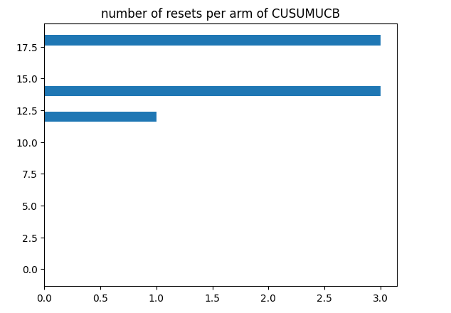
Requirement 3 - CUSUM
CUSUM-UCB Agent
Uses a two phases approach: Estimation and Detection
Cumulative regret is slightly better than SWUCB: SWUCB reaches over 2000 at t=10000, whereas CUSUM-UCB remains around 1400 at the same point.

Slide 17
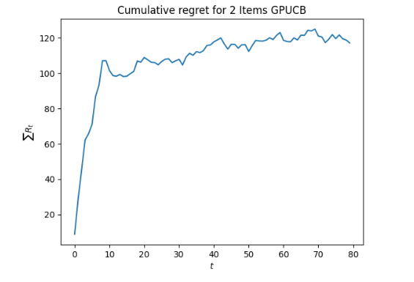
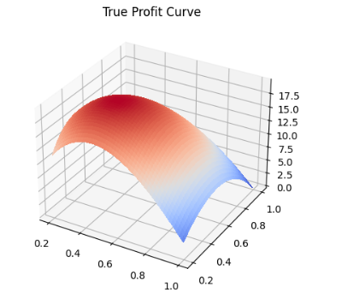
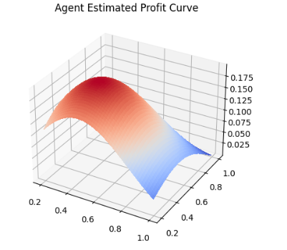

Requirement 3: bonus
2-item stochastic pricing environment
Continuous set of prices in [0,1]
As shown in the graph, the Double Gaussian Process UCB Agent achieve a sublinear regret
We consider 2 simmetric demand curves (one for each item)

Slide 18
REQUIREMENT 4

Slide 19
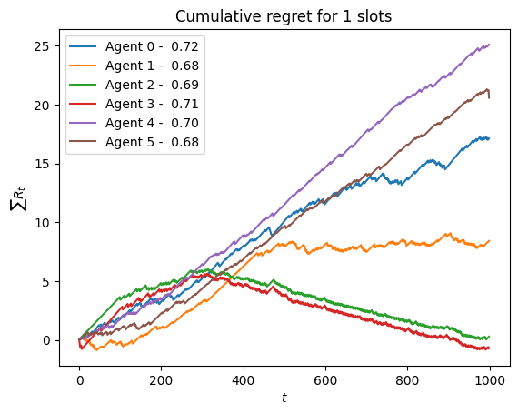
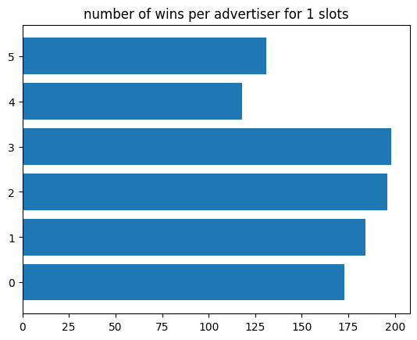
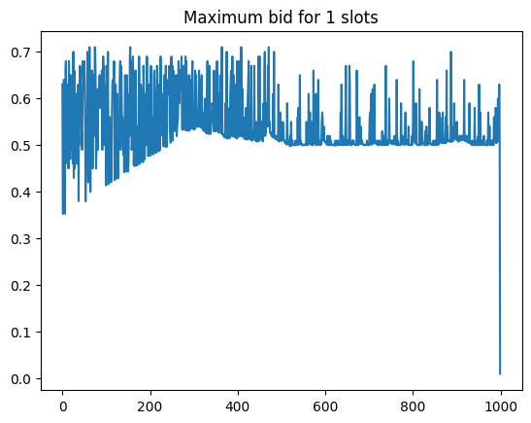
Requirement 4
Generalized First-Price Auction (Non-truthful)
We consider 6 agents:
- 0-1 UCB Bidding Agents
- 2-3 Multiplicative Pacing Agents (Truthful auctions)
- 4-5 Full Feedback Multiplicative Agents (Non-truthful auctions)
Considering a single slot auction:
The best performing are MP agents
Seconds are UCB agents
Setting
Number of users: 1000
Budget: 100
Random valuations

Slide 20
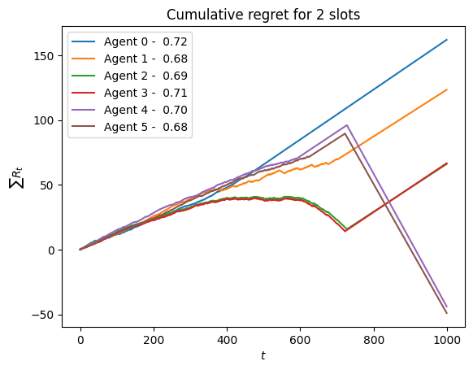
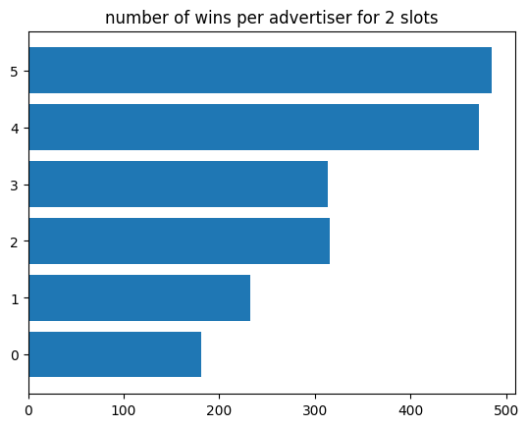
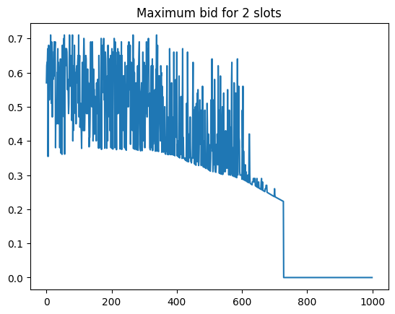
Requirement 4
Considering a 2 slots auction:
The best performing are FF MP agents
Seconds are MP agents
It is clear that MP agents overcome UCB in most of the scenarios
UCB agents start winning when MP agents have depleted all their budgets

Slide 21
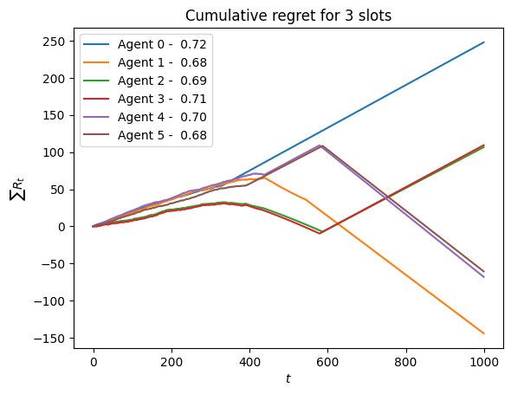
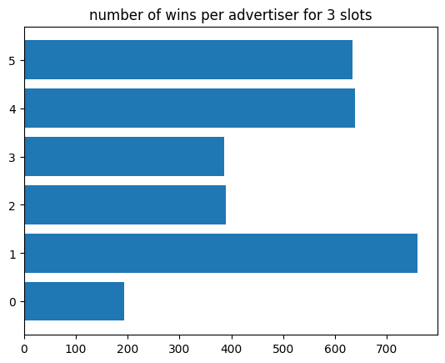
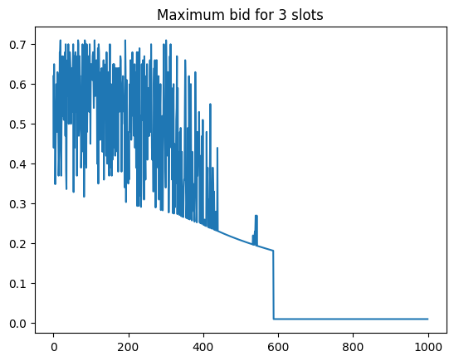
Requirement 4
Considering a 3 slots auction:
The best performing are FF MP agents
Seconds are MP agents
Budget depletion happens earlier
UCB agents start performing better when MP agents have their budget depleted

Slide 22
Questions?

